Slide 1
ONLINE PARKING RESERVATION SYSTEM
SAHIL MALKANIA
SARVESH NAGAR
SAKSHAM CHATURVEDI
RAJKAMAL KUMAR

Slide 2
Abstract of the Project
The Online Parking Reservation System (OPRS) is a system that enables customers/drivers to reserve a parking space. It also allows the customers/drivers to view the parking status.
It was developed because of congestion and collision of the vehicles. Therefore, the project aimed at solving such problems by designing a web-based system that will enable the customers/drivers to make a reservation of available parking space.
The designed system was implemented using different development tools which include HTML for creating interfaces, CSS for styling web pages, JavaScript, and jQuery for dynamism in the web pages and as an input validation tool.
MongoDB will be used to build the database and Node.js used as a server-side scripting language to connect the user interfaces to the database. The system was tested by the researchers for errors

Slide 3
Introduction
The parking place is very important all over the world especially in the cities like Delhi, Bangalore, Mumbai, etc. Every day thousands of car drivers spend a lot of the time to find where to park. The result of this situation is theft in urban areas, increasing traffic congestion and frustration of drivers. In order to solve this problem, the implementation of Online Parking Reservation System for managing parking places is mandatory. It will allow the drivers to Reserve a parking place anytime, anywhere. Searching for a vacant parking space in a metropolitan area is the daily concern for most people and it is time consuming. The system heavily relies on human interaction with the physical space and entity. This leads to wastage of human manpower and also parking spaces at times. It commonly results more traffic load and air pollution in certain area only for an available parking space.

Slide 4
Specific Objectives:
• To establish possible solutions to improve on the current Vehicle Parking Reservation system
• To design and implement Online Vehicle Parking Reservation system
• To make a good research about People’s Park and gather all necessary information that helped in designing the new parking reservation system.

Slide 5
Brief literature survey
A. State-of-the-Art Parking Management Searching for comparison between different transport parking guidance policy. Many parking guidance systems has been developed in the last decade. This sub-section we study the methods of guidance for many of the existing parking and explain their limitations.
B. Information Sharing Parking This mechanism is commonly smart parking system design is adopted by the current status. After publishing smart parking drivers parking availability information system specific to the field, where the driver receives parking availability information is available, according to the parking spaces will be decided in their desired destination parking.
C. Traffic volume In our proposed model, the traffic volume is defined as the amount of traffic generated especially for parking. This component is not negligible and traffic congestion and related pollution. Based smart parking system parking caused by the reduction in traffic volume for the proposed reservation, and is designed to meet the need for drivers.

Slide 6
Project goals & deliverables:
To establish possible solutions to improve on the current Vehicle Parking Reservation system
To design and implement Online Vehicle Parking Reservation system
To make a good research about People’s Park and gather all necessary information that helped in designing the new parking reservation system

Slide 7
Features:
This application provides the platform to pre-book parking spaces.
Provides searching facilities based on various factors such as duration, parking slots, parking fees.
Managing the information of vehicles.
Deals with monitoring the information and transaction of customers.
Shoes the information and description of the duration and parking spots.

Slide 8
Main functionalities of project
Login/Signup Page: - Here users and admin can provide credentials to login or signup to access the application.
For Admin: Admin can manage the bookings and users.
For User: User can search for appropriate parking space according to their location, choose time duration for parking, cancel bookings.
After selection of a location, next page will contain the details of parking space available with time slots. User have to select parking slot according to his/her convenience
After selection of slot, next page will show price. User have to confirm booking.
On next page payment options are provided.
There will be a page of transaction history and a page for support and to contact us.
There will be a slider for deals on bookings and traffic rules.
Main task is to manage the user credentials on firebase, and also to manage number of products ordered, type of brand, the dealer for whom the order has been received.

Slide 9
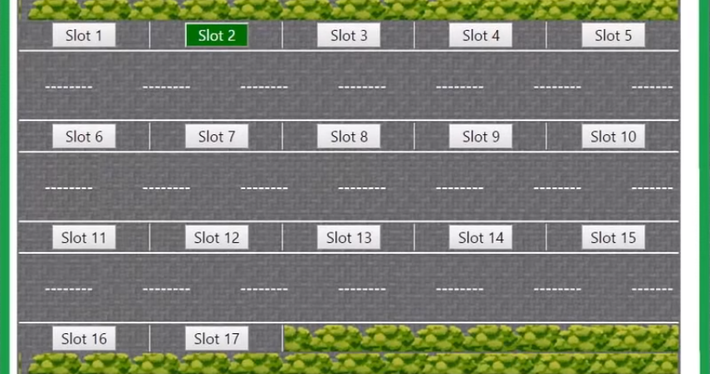

Slide 10
Thank You

